Slide 1
Consumer Insights & Intent Q2 2022
OOH Opportunities
Back-to-School, Fast Food, Political, Cannabis and Sports Betting Ad Engagement
June 2022

Slide 2
OAAA Q2 CONSUMER TRENDS FOR OOH
TABLE OF CONTENTS
Key Takeaways | p.3
Macro Consumer Outlook | p.5
OOH Influence on Back-to-School Shopping | p.12
OOH QSR Engagement | p.21
OOH Political Advertising | p.25
OOH Ads for Cannabis and Sports Betting | p.28
METHODOLOGY
Dates
May 31st – June 3, 2022
Survey Length
10 minutes
Method
Online
Audience
1000 Adults 18+
Data is weighted to reflect the U.S. general public across age, gender, race/ethnicity, region, income, household size, and employment.
“Consumer Insights and Intent Q2 2022 – OOH Product Opportunities” was sponsored by The Foundation for Outdoor Advertising Research and Education (FOARE), a 501 (c) (3) not for profit, charitable organization

Slide 3
Key Takeaways
 | Back to School Shoppers Plan to Spend More This Year: Three quarters (75%) of shoppers say they plan to spend more than usual on back-to-school products, and among those planning to spend more, a third (32%) saying they plan to spend a lot more than usual. More than half (56%) say they expect to spend up to $500 on products, and (44%) expect to spend more than $500.
 | Summer is Prime Time for BTS Shopping: Three in five (63%) of back-to-school shoppers say they will be shopping in mid-to-late summer, with (43%) planning to shop in August and (20%) in July
 | BTS Shoppers Will Be Flocking to Brick-and-Mortar Stores: Most back-to-school shoppers (69%) plan on visiting physical retail stores for products while (40%) will shop online
 | The Top Sellers Are Clothing and Tech: While back-to-school shoppers plan on spending money on various items (64% misc. supplies, 60% shoes, 53% clothing), shoppers expect to spend the most on clothing (24%) and laptops/personal computers (20%)
 | Price is the Key Driver of Choice: (70%) of back-to-school shoppers say price/sales/promotions will influence their purchases, and (88%) of back-to-school shoppers who plan to spend more on products this year say ads regarding value/savings are relevant to their shopping
 | OOH’s Massive Megaphone: Over two-thirds (68%) of back-to-school shoppers will be looking for OOH ads regarding special sales and deals as they make their buying decisions

Slide 4
Key Takeaways
 | Recall and Engagement are High for OOH QSR Ads: Three in five (59%) of Americans recall seeing a quick service restaurant OOH ad recently; especially younger Americans with three quarters (77%) of Gen Z and (76%) of Millennials. Almost nine in 10 (87%) report the ad produced an engagement with them.
 | OOH QSR Ads Are Leading to In Store Purchases and Driving Online Activation: Among those who recalled seeing a recent OOH QSR ad, 67% made a purchase at the store’s physical location, while 39% report ordering from the restaurant’s app, and 39% visited the store’s website.
 | OOH Political Ads Are Influencing Young Americans Most: Seven in 10 (73%) of Millennials and (71%) of Gen Zers said their opinions about candidates or issues were affected in some way by OOH political ads, and over half of US adults are influenced by them.
 | Engagement is High with Cannabis and Sports Betting OOH Ads: (62%) of those who saw ads for sports betting and (59%) of those who saw ads for cannabis products engaged in some way after seeing the OOH ads. Sharing info via word-of-mouth was the most common engagement (51% and 54% respectively), followed by website visitation (48% and 47%), purchasing (45% and 41%), and social media following (39% and 30%).
 | OOH Ads for Cannabis and Sports Betting Reach Urbanites Most: (47%) of Urban 1M+ have recently noticed OOH ads for cannabis products, and (54%) for sports betting/gambling.

Slide 5
Macro Consumer Outlook

Slide 6
Majority Are Optimistic The Worst of COVID Is Finally Behind Us
THE HARRIS POLL: COVID-19 IN THE U.S.
Do you believe the worst of COVID-19 is behind us or is the worst still ahead of us?
Worst is ahead of us
Worst is behind us
CDC reports COVID cases stabilizing
Omicron
outbreak
Source: Harris Poll COVID19 Tracker Wave 119 (6/3-6/5/22)
BASE: GENERAL PUBLIC W119 (n=1994)
CFP03. Do you believe the worst of COVID-19 is behind us or is the worst still ahead of us?

Slide 7
But With Wall Street In A Bear Market, The Economy Is The #1 Fear
THE HARRIS POLL: COVID-19 IN THE U.S.
Wave Change
Economy, inflation, jobs
+1
War on Ukraine
Trended Fear Curves During COVID-19
-2
Crime Rates
Fear of new
variant
Political Divisiveness
-2
-4
Fear of new wave
+2
Fear global
recession
+1
+2
+2
Fear healthcare
shortage
Fear returning to public activity
Monkeypox
+3
0
+2
Fear losing job
Fear of dying
Omicron
outbreak
-3

Slide 8
The Majority Say the Worst of Inflation is Still Ahead
THE HARRIS POLL: COVID-19 IN THE U.S.
How concerned are you about inflation rates?
In regard to inflation, do you think the worst is behind us or still ahead of us?
The worst is still ahead of us
-3%-pts since 3/11/22
86% Boomers
83% GOP
81% <50K HHI
90%
concerned
The worst is behind us
Source: Harris Poll COVID19 Tracker Wave 120 (6/10-6/12/22)
BASE: GENERAL PUBLIC (n=1000); W120 (n=2018)
INF16. In regard to inflation, do you think the worst is behind us or still ahead of us?
Q19. Switching topics, generally speaking, how concerned are you about inflation rates?

Slide 9
Inflation Is Impacting Consumers’ Ability to Afford Groceries Across Demographics
OAAA Q2 CONSUMER TRENDS FOR OOH
How much is inflation impacting your ability to afford groceries?
BASE: GENERAL PUBLIC (N=1000)
Q20. How much is inflation impacting your ability to afford groceries?

Slide 10
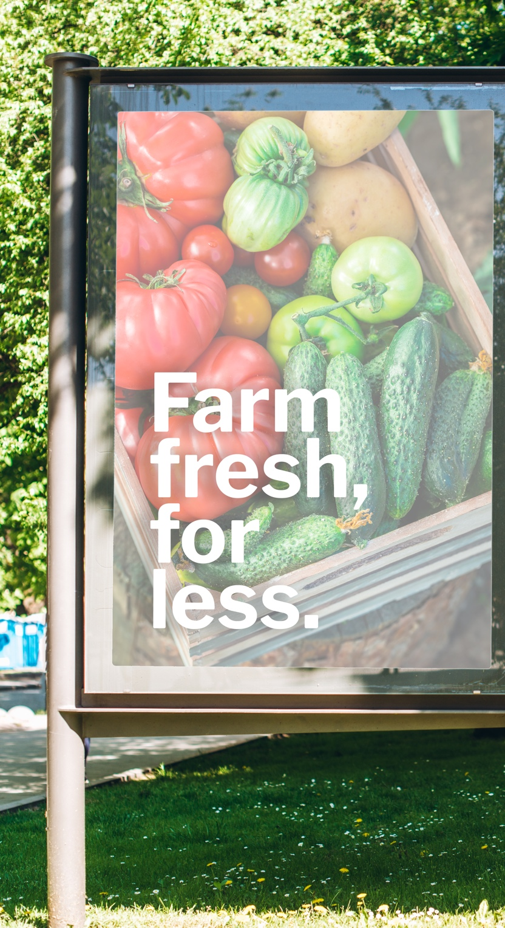
Today’s Consumers Are More Aware of OOH Ads for Grocery Sales, Especially Millennials and Gen Z
OAAA Q2 CONSUMER TRENDS FOR OOH
Would you say you are currently paying more attention, less, or the same amount of attention to out-of-home advertising that showcases sales or promotions for groceries compared to 3 and 6 months ago?
% More
BASE: GENERAL PUBLIC (N=1000)
Q21. Would you say you are currently paying more attention, less, or the same amount of attention to OOH
advertising that showcases sales or promotions for groceries compared to 3 and 6 months ago?

Slide 11
OOH Ads Help Consumers Save Money on Groceries & They Want to See More of Them
OAAA Q2 CONSUMER TRENDS FOR OOH
How helpful have these out-of-home advertisements you have seen been in helping you save money on groceries?
Would you like to see more out-of-home advertising that showcases sales or promotions for groceries?
Among those who have paid more or the same amount of attention to grocery ads
Among those who have paid more or the same amount of attention to grocery ads
82% Millennials
71% Urban 1M+
BASE: PAYS MORE OR THE SAME ATTENTION TO ADS (N=918)
Q22. And how helpful have these out-of-home advertisements you have seen been in helping you save money on groceries? Q23. Would you like to see more out-of-home advertising that showcases sales or promotions for groceries?

Slide 12
OOH Influence on Back-to-School Shopping

Slide 13
With In-Person Learning Resuming, Majority of BTS Shoppers Plan to Spend More
Now that the majority of education is back to in-person learning, do you plan to spend more on back-to-school products this year versus last?
Generally speaking, how much more do you plan on spending?
Among back-to-school shoppers
Among back-to-school shoppers planning to spend more
43% Urban 1M+
36% Men
75%
plan to spend more
BASE: BACK TO SCHOOL SHOPPERS (N=427); SPENDING MORE ON BTS SHOPPING (N=320)
Q11. And now that the majority of education is back to in-person learning, do you plan to spend more on back-to-school products this year versus last?
Q12. Generally speaking, how much more do you plan on spending?

Slide 14
More Than Half of BTS Shoppers Plan to Spend Up to $500 and a Third Say Between $500-$1K
How much do you plan to spend this year on back-to-school products? Your best guess is fine.
Among back-to-school shoppers
46% Men
45% Millennials
15% Urban 1M+
14% 100K+ HHI
69% Women
61% Gen X
BASE: BACK TO SCHOOL SHOPPERS (N=444)
Q10. How much do you plan to spend this year on back-to-school products? Your best guess is fine.

Slide 15
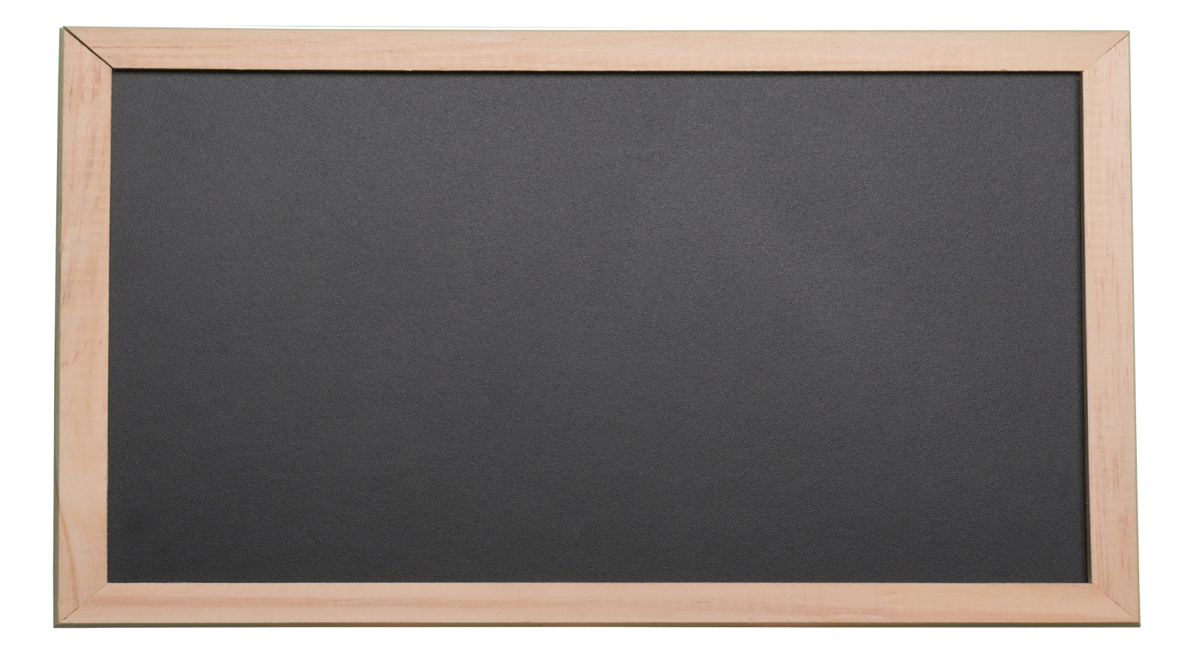
Most Plan to Do Majority of BTS Shopping in Mid-To-Late Summer
When do you plan to do the majority of your back-to-school shopping?
What education level will the majority of your back-to-school purchases be for?
Among back-to-school shoppers
Among back-to-school shoppers
I plan to buy a little each month from now until the start of school
SEP
AUG
JUL
10%
13%
43%
20%
No specific month planned
JUN
7%
7%
BASE: BACK TO SCHOOL SHOPPERS (N=444)
Q7. What education level will the majority of your back-to-school purchases be for? Please select only one.
Q5. Thinking about getting all the things you need for returning to education/going back-to-school, when do you plan to do the majority of your back-to-school shopping? Please select one.

Slide 16
Majority Plan to Do Most of BTS Shopping at Brick-and-Mortar Stores
Where will you do the majority of your back-to-school shopping? Please select up to three.
Among back-to-school shoppers
69%
77% Suburban
75% Women
51% $50-100K HHI
26% Millennials
24% Men
14% Urban 1M+
Somewhere else
Electronics store
Store associated with the school
Mall specialty store
Big box stores
Office supply stores
Department Stores
Dollar Stores
Online
Retail stores
BASE: BACK TO SCHOOL SHOPPERS (N=444)
Q6. Where will you do the majority of your back-to-school shopping? Please select up to three.

Slide 17
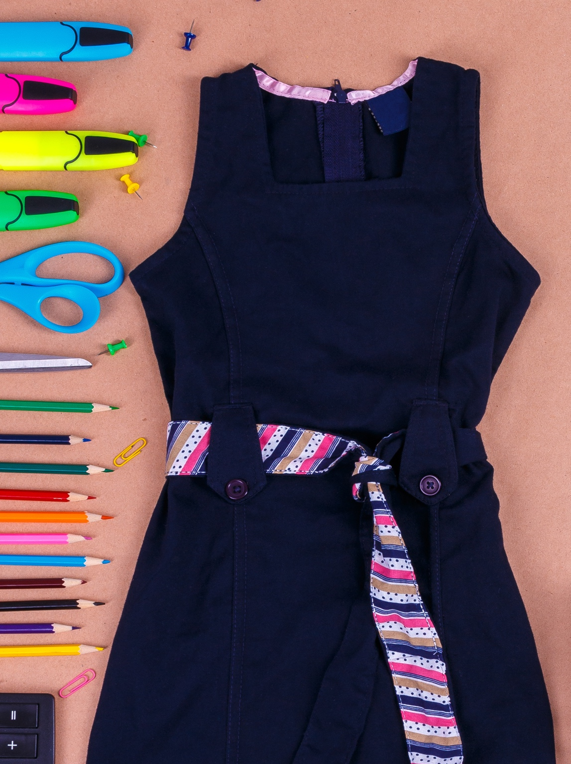
BTS Shoppers Plan to Spend The Most on Clothing & Personal Tech
When shopping for back-to-school products, which of the following items do you plan to buy? Please select all that apply.
Which of the following items do you expect to spend the most on for back-to-school shopping? Please select one.
Among back-to-school shoppers
Among back-to-school shoppers
BASE: BACK TO SCHOOL SHOPPERS (N=444)
Q8. When shopping for back-to-school products, which of the following items do you plan to buy? Please select all that apply.
Q8A. Which of the following item do you expect to spend the most on for back-to-school shopping? Please select one.

Slide 18
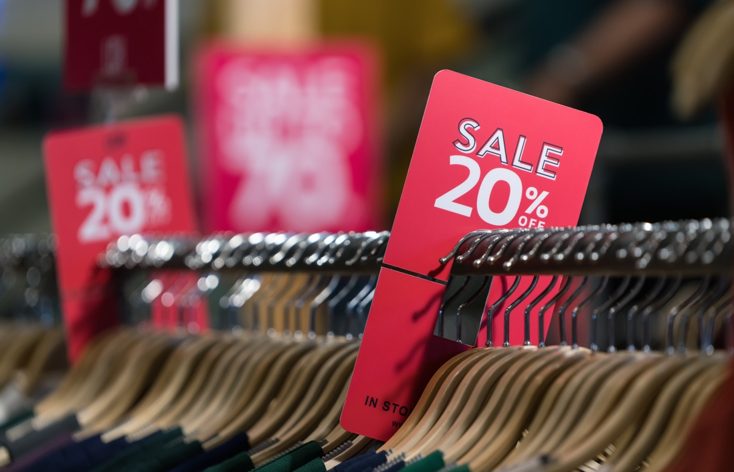
Price Will Be the Biggest Driver of Choice for BTS Shoppers
Which, if any, of the following will influence your purchase decision when it comes to buying back-to-school supplies? Please select all that apply.
81% Women
78% Suburban
Among back-to-school shoppers whose purchases are influenced
42% Millennials
BASE: BTS PURCHASES ARE INFLUENCED (N=428)
Q9. Which, if any, of the following will influence your purchase decision when it comes to buying back-to-school supplies? Please select all that apply.

Slide 19
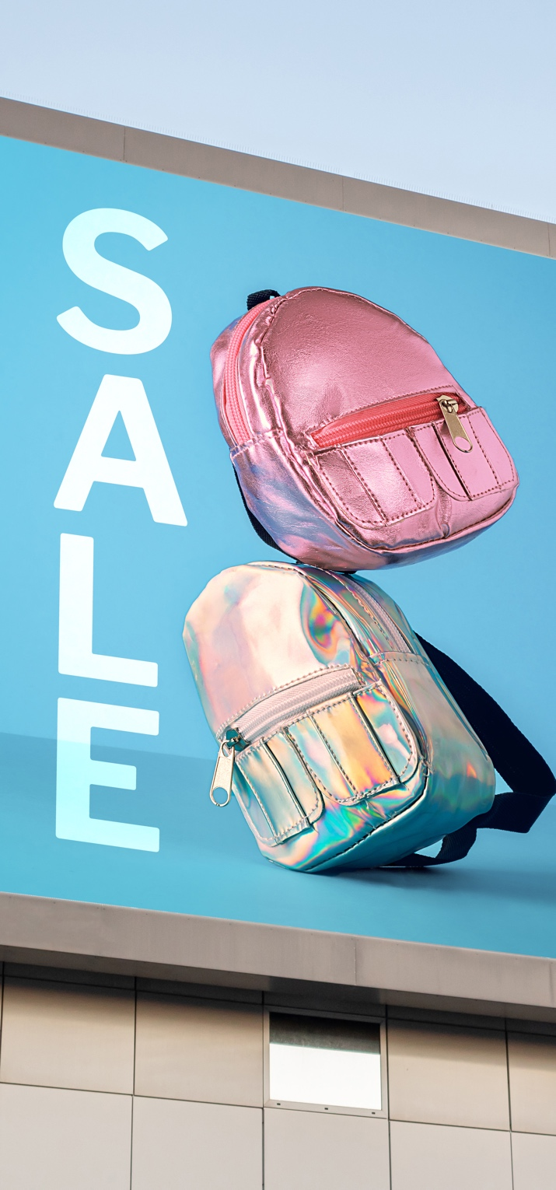
Majority of BTS Shoppers Will Be Looking for Deals from OOH Ads
When making your back-to-school buying decisions, how much will you be looking for out-of-home advertisements promoting/offering special sales and deals?
Among back-to-school shoppers
% Very much/Somewhat
68%
will be looking for OOH ads regarding BTS deals
BACK TO SCHOOL SHOPPERS (N=444)
Q14. When making your back-to-school buying decisions, how much will you be looking for out-of-home out-of-home advertisements promoting/offering special sales and deals?
* Small base size (N < 100)

Slide 20
Savings, Convenience, Community: Especially Key for Millennials & Urbanites 1M+
How relevant do you find the following types of advertisements regarding back-to-school shopping?
Among back-to-school shoppers spending more on supplies
Relevant (NET)
92% Suburban
91% Millennials
90% Urban
88% $50-100K HHI
87% Urban 1M+
82% Millennials
87% Urban 1M+
81% Millennials
BASE: SPENDING MORE ON BTS SUPPLIES (N=320)
Q13. How relevant do you find the following types of advertisements regarding back-to-school shopping?

Slide 21
OOH QSR Engagement

Slide 22
Six in Ten Recall Seeing OOH QSR Ads Recently, Especially Younger & Urban Americans
Do you recall seeing recently an OOH advertisement for quick-service or fast-food restaurants?
% Yes
BASE: GENERAL PUBLIC (N=1000)
Q1. Do you recall seeing recently an out-of-home advertisement for quick-service or fast-food restaurants (e.g., Chipotle, Dairy Queen, Domino’s, McDonald’s, Panera, Starbucks, Subway)?

Slide 23
OOH QSR Ads Engaged Almost 9 in 10 Recent Viewers
For those out-of-home advertisements for quick-service or fast-food restaurants that you’ve noticed recently, have they led you to do any of the following? Please select all that apply.
Among those who have engaged with OOH QSR ads
87% Boomer+
61% Gen Z
32% Urban 1M+
67%
of those who saw a QSR OOH ad made a purchase at a physical store
BASE: ENGAGED WITH QSR ADS (N=532)
Q3. For those out-of-home advertisements for quick-service or fast-food restaurants that you’ve noticed recently, have they led you to do any of the following? Please select all that apply.

Slide 24
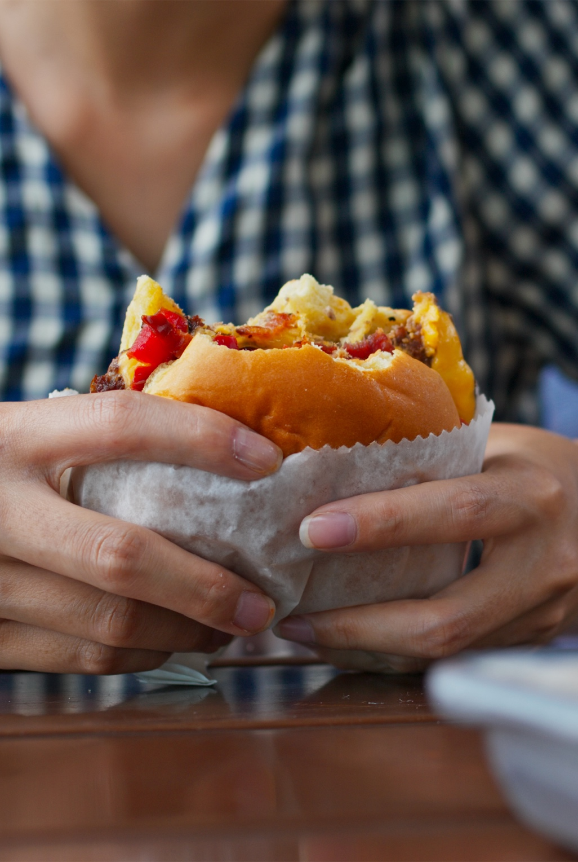
Consumers Look to OOH QSR Ads for Information on Price & New Products
Which type of out-of-home advertising messages for quick-service or fast-food restaurants are most likely to interest you? Please select up to three.
Among those interested in OOH QSR ads
51% Rural
Gen Z 42%
Millennials 37%
37% Rural
35% Urban <1M
Price
New product offerings
Limited-time menu offerings
Food quality
Nearby location or directional
Combination meals
Related to specific times of the day
Partnership with delivery companies
Business hours
BASE: INTERESTED IN QSR ADS (N=875)
Q2. Which type of out-of-home advertising messages for quick-service or fast-food restaurants are most likely to interest you? Please select up to three.

Slide 25
OOH Political Advertising

Slide 26
Voters Are Hyper-Aware of OOH Political Ads Compared to Non-Voters
Do you plan to vote in the midterm primaries or general elections in 2022?
When was the last time you noticed a political advertisement on a billboard, bus or bus stop, outdoor video screen, poster and other outdoor signage?
Over Half of Voters (55%) Have Seen OOH Political Ads Within The Last Month
BASE: GENERAL PUBLIC (N=1000)
Q15. Switching topics, do you plan to vote in the midterm primaries or general elections in 2022?
Q16. When was the last time you noticed a political advertisement on a billboard, bus or bus stop, outdoor video screen, poster and other outdoor signage?

Slide 27
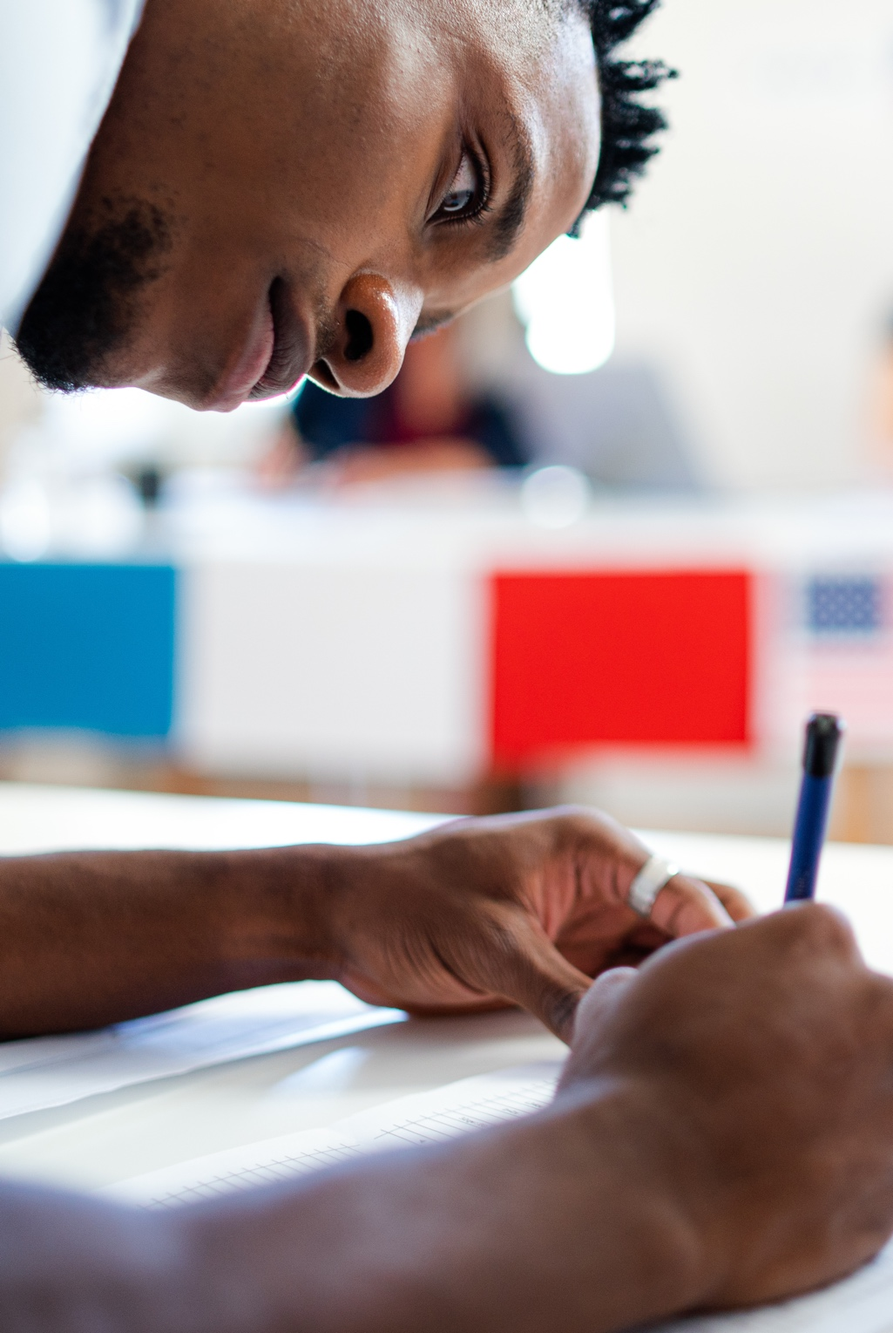
OOH Political Ads Influence Over Half Of Viewers, Especially Younger Adults
How do political advertisements affect your opinion about candidates or issues? Please select all that apply.
Adults influenced by OOH political ads
73% Millennials | 71% Gen Z | 49% Gen X
41% Gen Z
34% Millennials
Increase awareness on issues
Generates interest for me to do more research on candidates or issues
Increases my intention to vote for a candidate
They don’t affect my opinion about candidates or issues
Not sure
BASE: GENERAL PUBLIC (N=1000)
Q17. How do political advertisements affect your opinion about candidates or issues? Please select all that apply.

Slide 28
OOH Ads for Cannabis and Sports Betting

Slide 29
OOH Ads for Cannabis & Sports Betting Are Reaching Urban Americans Most
Have you recently noticed any out-of-home advertisements for the following products?
Cannabis products
Sports betting/gambling
Yes
No
Yes
No
BASE: GENERAL PUBLIC (N=1000)
Q18A. Have you recently noticed any out-of-home advertisements for the following products?

Slide 30
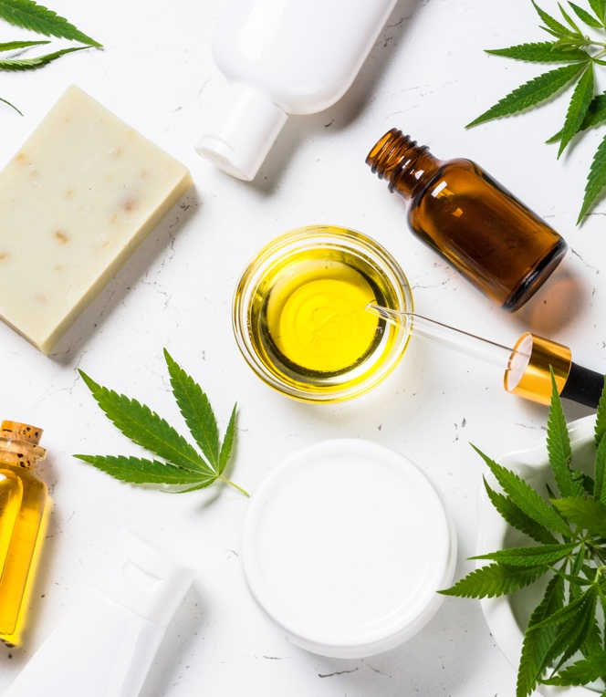
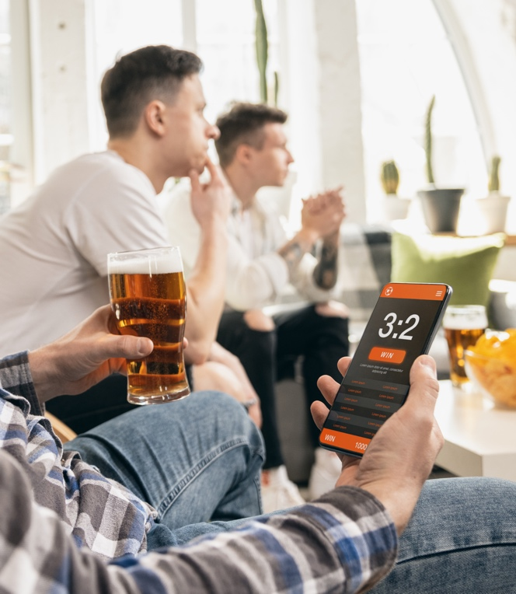
Cannabis & Sports Betting OOH Ads Drive Engagement with About 60% of Viewers
Has seeing the advertisements for the following products prompted you to do any of the following? Please select all that apply.
62% of those who saw ads for sports betting and 59% of those who saw ads for cannabis products engaged after seeing ads
Among those who engaged after seeing ad
46% Millennials
Cannabis products
34% Millennials
Sports betting
Shared by word-of-mouth information about the advertiser with family or friends
Visited the advertiser's website
Made a purchase at a physical retail location
Followed the advertiser on social media
Made a purchase online
Used QR code, tap technology or SMS text to access an offer or information
Took a picture of the ad to share on social media
BASE: ENGAGED WITH CANNABIS ADS (N=236) ; ENGAGED WITH SPORTS BETTING ADS (N=238)
Q18. Has seeing the advertisements for the following products prompted you to do any of the following? Please select all that apply.

Slide 31
Cannabis Tourism: Legality is Important to About Half of Millennials and Gen Z
When choosing a destination for vacation, how important is it to you that the state you are visiting have legal recreational cannabis?
Among 21+ Americans
% Important
30%
Very Important/ Somewhat Important
Source: Harris Poll COVID19 Tracker Wave 116 (5/13-5/15/22)
BASE: Among Americans 21+ W116 (n=1961)
WT03. When choosing a destination for vacation, how important is it to you that the state you are visiting have legal recreational cannabis?

Slide 32
Young Americans Likely To Use Cannabis In Legal States While Vacationing
If on vacation in a state with legal recreational cannabis, how likely would you be to consume cannabis products?
Among 21+ Americans
% Likely
38%
Very Likely/ Somewhat Likely
88% Among Cannabis Users
Source: Harris Poll COVID19 Tracker Wave 116 (5/13-5/15/22)
BASE: Among Americans 21+ W116 (n=1961)
WT05 If on vacation in a state with legal recreational cannabis, how likely would you be to consume cannabis products?

Slide 33
Gen Z & Millennials: Interested In Combining Cannabis Throughout Vacation Itinerary
How interested would you be in using recreational cannabis while doing each of the following activities if on vacation?
Among 21+ Americans
Interested (NET)
70% Millennials
63% Gen Z
67% Millennials
66% Gen Z
62% Millennials
59% Gen Z
60% Millennials
55% Gen Z
60% Millennials
53% Gen Z
57% Millennials
63% Gen Z
Source: Harris Poll COVID19 Tracker Wave 116 (5/13-5/15/22)
BASE: Among Americans 21+ W116 (n=1961)
WT06. How interested would you be in using recreational cannabis while doing each of the following activities if on vacation?

Slide 34
“Consumer Insights and Intent Q2 2022 – OOH Back-to-School Opportunities” was sponsored by The Foundation for Outdoor Advertising Research and Education (FOARE), a 501 (c) (3) not for profit, charitable organization.

