Slide 1
Consumer Insights & Intent Q2 2022
OOH Back-To-School Opportunities
June 2022

Slide 2
OAAA Q2 CONSUMER TRENDS FOR OOH
CONTENTS
Key Takeaways – p. 3
OOH Influence on Back-To-School Shopping – p. 4
METHODOLOGY
Dates
Method
May 31 – June 3, 2022
Online
Survey Length
Audience
10 minutes
1,000 Adults 18+
Data is weighted to reflect the U.S. general public across age, gender, race/ethnicity, region, income, household size, and employment.

Slide 3
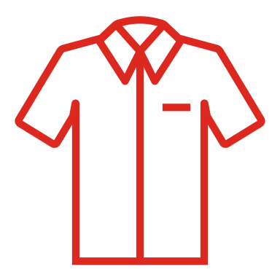
Key Takeaways
 | Back to School Shoppers (BTS) Plan to Spend More This Year: Three quarters (75%) of shoppers say they plan to spend more than usual on BTS products, and among those planning to spend more, a third (32%) saying they plan to spend a lot more than usual. More than half (56%) say they expect to spend up to $500 on products, and (44%) expect to spend more than $500.
 | Summer is Prime Time for BTS Shopping: Three in five (63%) of BTS shoppers say they will be shopping in mid-to-late summer, with (43%) planning to shop in August and (20%) in July.
 | BTS Shoppers Will Be Flocking to Brick-and-Mortar Stores: Most BTS (69%) plan on visiting physical retail stores for products while (40%) will shop online.
 | The Top Sellers Are Clothing and Tech: While BTS shoppers plan on spending money on various items (64% misc. supplies, 60% shoes, 53% clothing), shoppers expect to spend the most on clothing (24%) and laptops/personal computers (20%).
 | Price is the Key Driver of Choice: (70%) of BTS shoppers say price/sales/promotions will influence their purchases, and (88%) of BTS shoppers who plan to spend more on products this year say ads regarding value/savings are relevant to their shopping.
 | OOH’s Massive Megaphone: Over two-thirds (68%) of back-to-school shoppers will be looking for OOH ads regarding special sales and deals as they make their buying decisions.

Slide 4
OOH Influence on Back-to-School Shopping

Slide 5
With In-Person Learning Resuming, Majority of BTS Shoppers Plan to Spend More
Now that the majority of education is back to in-person learning, do you plan to spend more on back-to-school products this year versus last?
Generally speaking, how much more do you plan on spending?
Among back-to-school shoppers
Among back-to-school shoppers planning to spend more
43% Urban 1M+
36% Men
75%
plan to spend more
BASE: BACK TO SCHOOL SHOPPERS (N=427); SPENDING MORE ON BTS SHOPPING (N=320)
Q11. And now that the majority of education is back to in-person learning, do you plan to spend more on back-to-school products this year versus last?
Q12. Generally speaking, how much more do you plan on spending?
*Caution: Small base size (n <100)

Slide 6
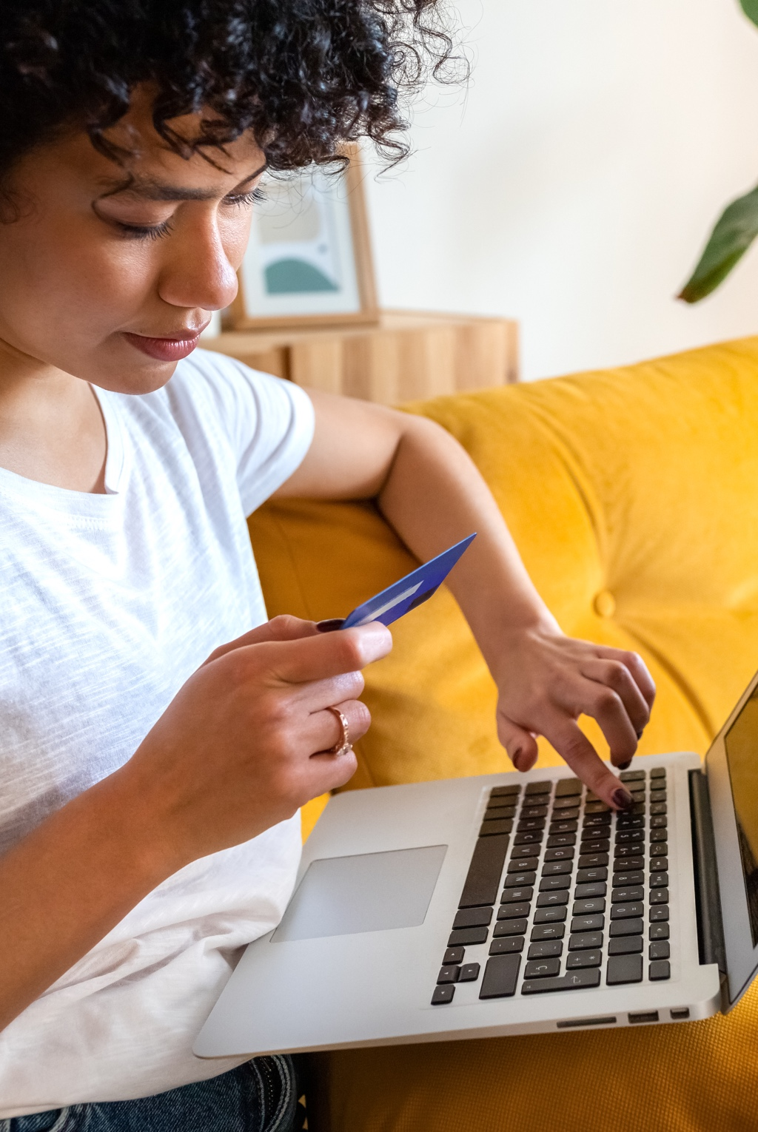
More Than Half of BTS Shoppers Plan to Spend Up to $500 and a Third Say Between $500-$1K
How much do you plan to spend this year on back-to-school products? Your best guess is fine.
Among back-to-school shoppers
46% Men
45% Millennials
15% Urban 1M+
14% 100k+ HHI
69% Women
61% Gen X
BASE: BACK TO SCHOOL SHOPPERS (N=444)
Q10. How much do you plan to spend this year on back-to-school products? Your best guess is fine.

Slide 7
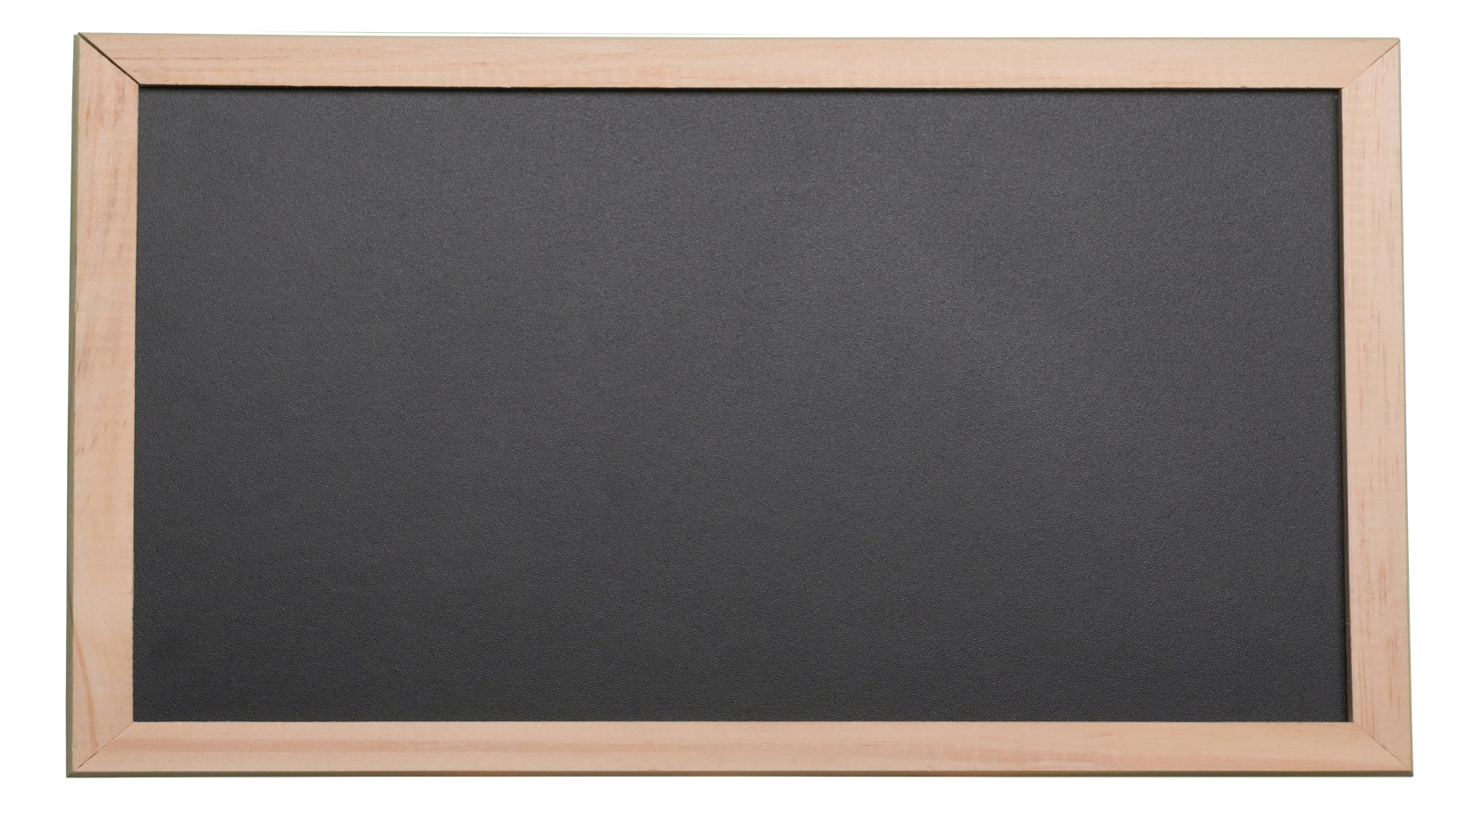
Most Plan to Do Majority of BTS Shopping in Mid-To-Late Summer
When do you plan to do the majority of your back-to-school shopping?
What education level will the majority of your back-to-school purchases be for?
Among back-to-school shoppers
Among back-to-school shoppers
I plan to buy a little each month from now until the start of school
SEP
AUG
JUL
10%
13%
43%
20%
No specific month planned
JUN
7%
7%
BASE: BACK TO SCHOOL SHOPPERS (N=444)
Q7. What education level will the majority of your back-to-school purchases be for? Please select only one.
Q5. Thinking about getting all the things you need for returning to education/going back-to-school, when do you plan to do the majority of your back-to-school shopping? Please select one.

Slide 8
Majority Plan to Do Most of BTS Shopping at Brick-and-Mortar Stores
Where will you do the majority of your back-to-school shopping? Please select up to three.
Among back-to-school shoppers
69%
77% Suburban
75% Women
51% $50-100K HHI
26% Millennials
24% Men
14% Urban 1M+
Somewhere else
Electronics store
Store associated with the school
Mall specialty store
Big box stores
Office supply stores
Dept. Stores
Dollar Stores
Online
Retail stores
BASE: BACK TO SCHOOL SHOPPERS (N=444)
Q6. Where will you do the majority of your back-to-school shopping? Please select up to three.

Slide 9
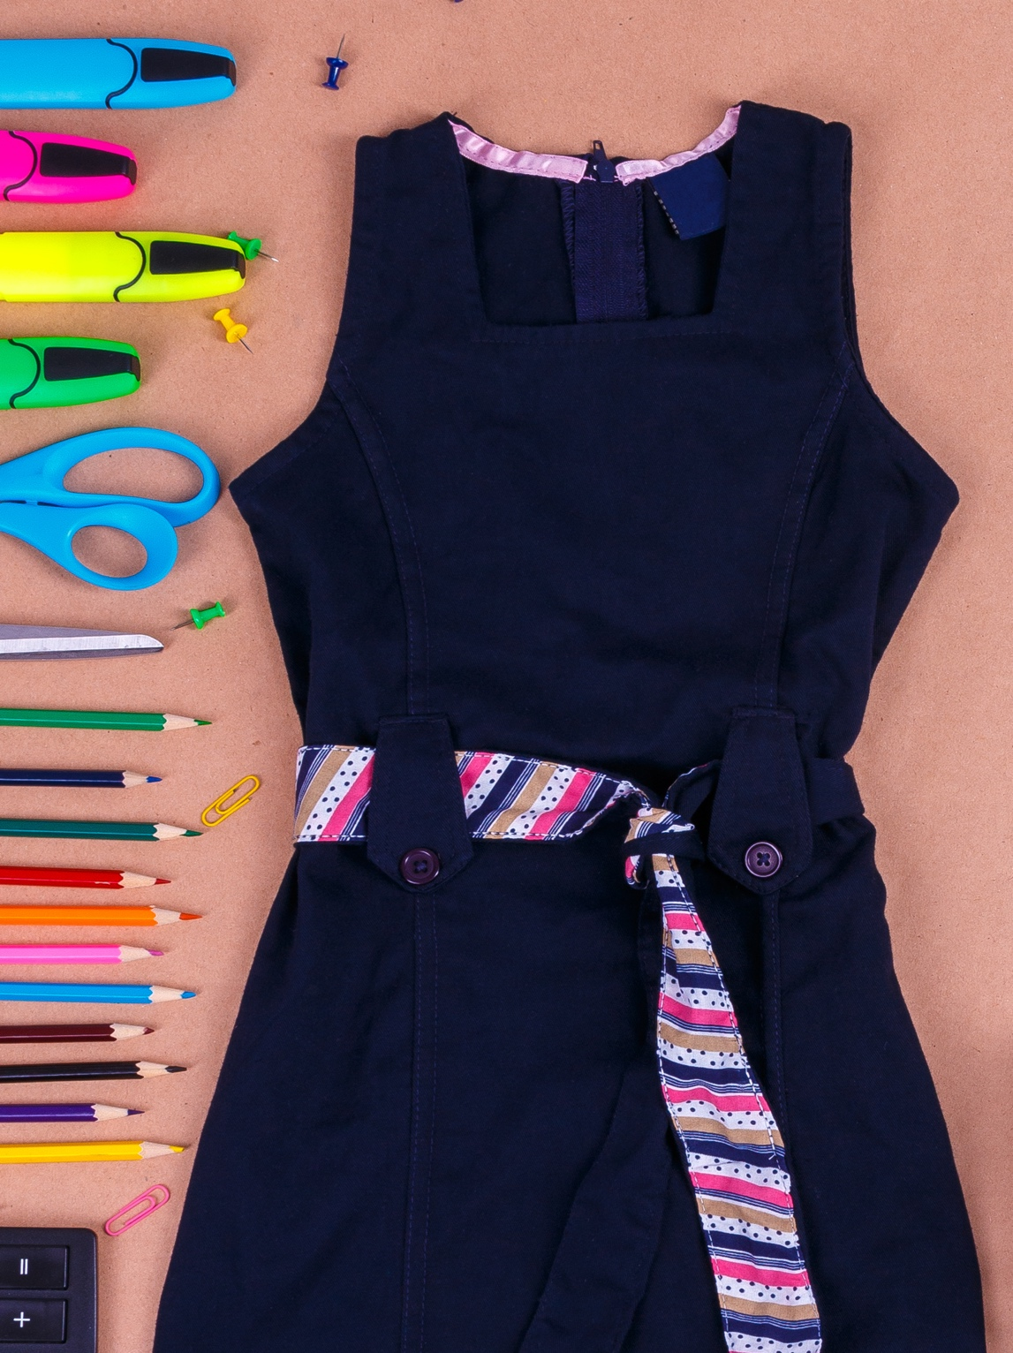
BTS Shoppers Plan to Spend The Most on Clothing & Personal Tech
When shopping for back-to-school products, which of the following items do you plan to buy? Please select all that apply.
Which of the following items do you expect to spend the most on for back-to-school shopping? Please select one.
Among back-to-school shoppers
Among back-to-school shoppers
BASE: BACK TO SCHOOL SHOPPERS (N=444)
Q8. When shopping for back-to-school products, which of the following items do you plan to buy? Please select all that apply.
Q8A. Which of the following item do you expect to spend the most on for back-to-school shopping? Please select one.

Slide 10
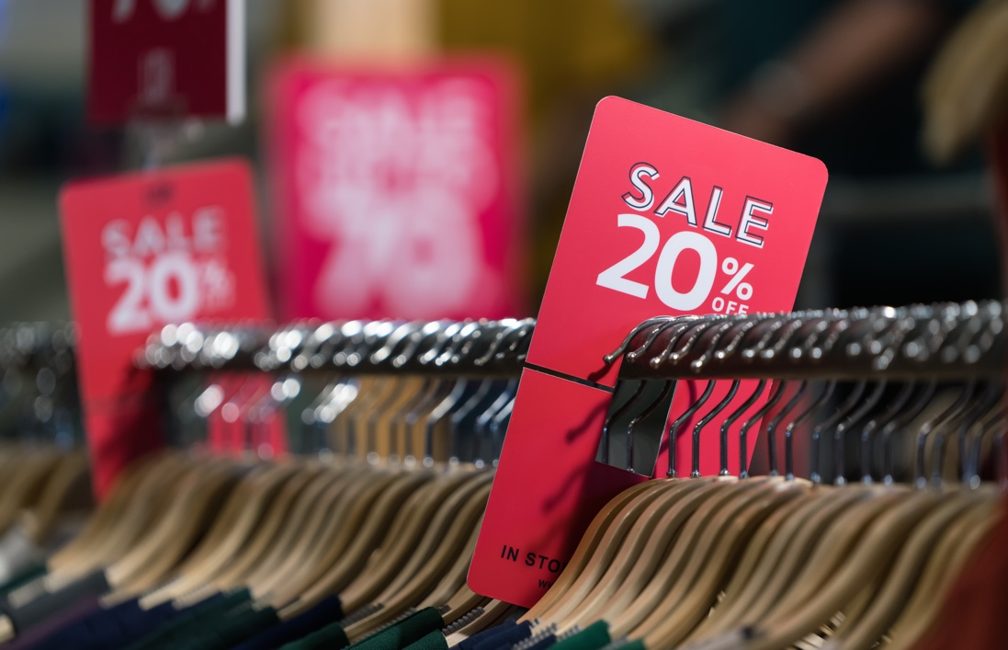
Price Will Be the Biggest Driver of Choice for BTS Shoppers
Which, if any, of the following will influence your purchase decision when it comes to buying back-to-school supplies? Please select all that apply.
81% Women
78% Suburban
Among back-to-school shoppers whose purchases are influenced
42% Millennials
BASE: BTS PURCHASES ARE INFLUENCED (N=428)
Q9. Which, if any, of the following will influence your purchase decision when it comes to buying back-to-school supplies? Please select all that apply.

Slide 11
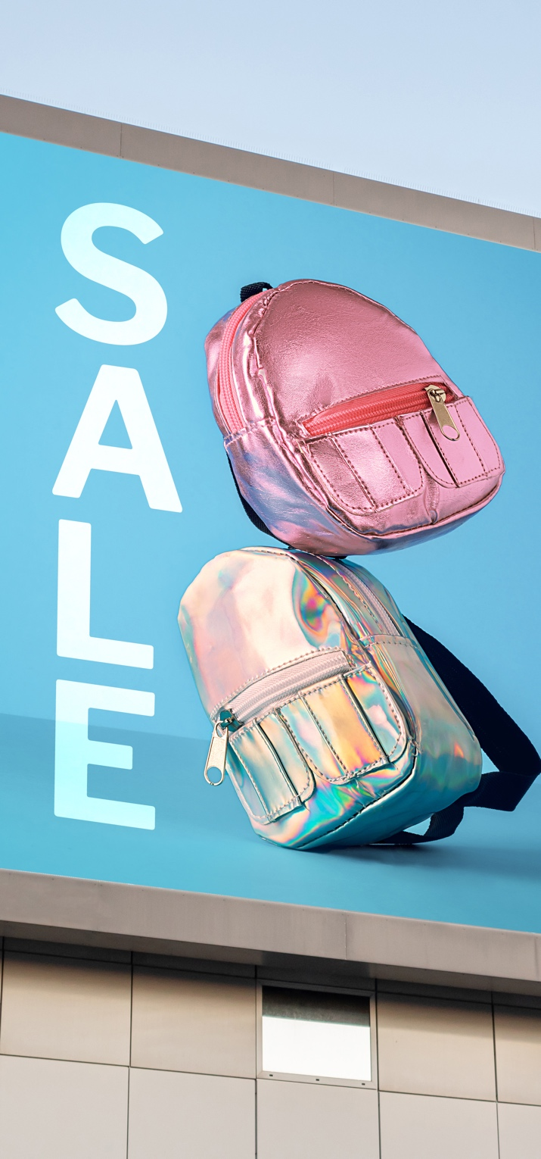
Majority of BTS Shoppers Will Be Looking for Deals from OOH Ads
When making your back-to-school buying decisions, how much will you be looking for out-of-home advertisements promoting/offering special sales and deals?
Among back-to-school shoppers
% Very much/Somewhat
68%
will be looking for OOH ads regarding back-to-school deals
BACK TO SCHOOL SHOPPERS (N=444)
Q14. When making your back-to-school buying decisions, how much will you be looking for out-of-home out-of-home advertisements promoting/offering special sales and deals?
* Small base size (N < 100)

Slide 12
Savings, Convenience, Community: Especially Key for Millennials & Urbanites 1M+
How relevant do you find the following types of advertisements regarding back-to-school shopping?
Among back-to-school shoppers spending more on supplies
Relevant (NET)
92% Suburban
91% Millennials
90% Urban
88% $50-100K HHI
87% Urban 1M+
82% Millenials
87% Urban 1M+
81% Millenials
BASE: SPENDING MORE ON BTS SUPPLIES (N=320)
Q13. How relevant do you find the following types of advertisements regarding back-to-school shopping?

Slide 13
“Consumer Insights and Intent Q2 2022 – OOH Back-to-School Opportunities” was sponsored by The Foundation for Outdoor Advertising Research and Education (FOARE), a 501 (c) (3) not for profit, charitable organization.

